Slide 1
Exposé on the Résumé
Investment Society
Fall 2017

Slide 2
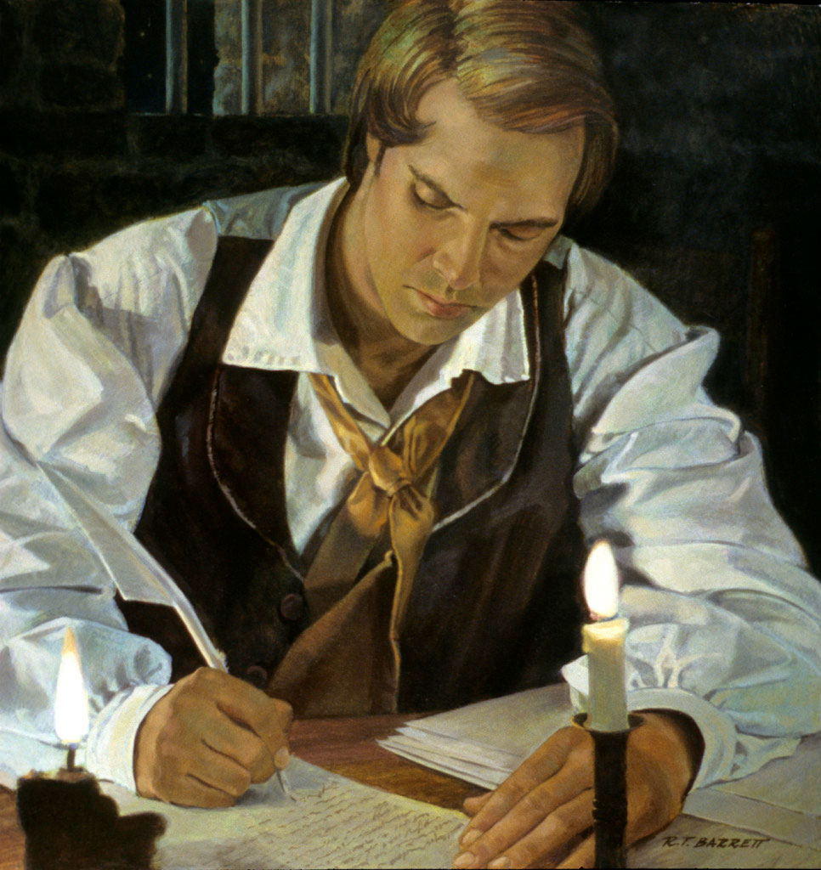
1842

Slide 3
1842
Joseph Smith writes the “Wentworth Letter”
Containing 13 Articles of Faith
Summary of our beliefs
Outward expression of our inner priorities
Put yourself in the same shoes…
Source: http://eom.byu.edu/index.php/Articles_of_Faith

Slide 4

curriculum vitae
noun
1824, from Modern Latin transferred use of classical Latin curriculum "a running, course, career" (also "a fast chariot, racing car"), from currere "to run.” From Latin vitae, literally "course of one's life"
résumé ('rezəˌmā)
noun
a brief account of a person’s education, qualifications, and previous experience, typically sent with a job application.
see also: curriculum vitae, CV
Wow…

Slide 5






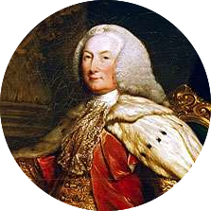


2017 – Video Resumes are in. Objective statements are out! Companies employ machine learning algorithms to parse your resume and compare you to other candidates. Resumes are now more important than ever!
1500- Traveling Lord in England of introduction to acquaintances and calls it his resume
1930 – Resumes are just formalities; mostly written on scraps of paper during a lunch or interview
1950 – Resumes are now required. Now including personal hobbies and interests
1989 – Microsoft releases Word. A new way to type professional documents! The age of technology is here!
2003 – LinkedIn launches. The way you market yourself to employers changes forever. You now must BUILD YOUR BRAND!
1482 – Leonardo De Vinci writes the first professional resume

Slide 7
What Makes a Resume Good?
“Most recruiting functions still use the resume as a cursory screening tool. In doing so, they fundamentally assume that people know what they’re doing when writing their resume.”- HireVue

Slide 8

The Must Haves!
Legible - No Typos or Grammar Errors
No Tall Tails (No Lying)
Contact Information Required
College
Cumulative / Major GPA
Expected Graduation Date
Chronological Work Experience
MUST BE SUMBITTED AS PDF

Slide 9

That’s just the minimum…
Each resume tailored to fit the job description
Use quantitative figures to prove your value
Use powerful & descriptive language to begin each statement
Be concise yet specific in your bullet points
ALWAYS REMEMBER S.T.A.R
Formulate all bullet points to satisfy this acronym
Situation/Task | Action | Results

Slide 10
“Good artists copy, great artists steal" – Pablo Picasso
- Dylan McDowell

Slide 11
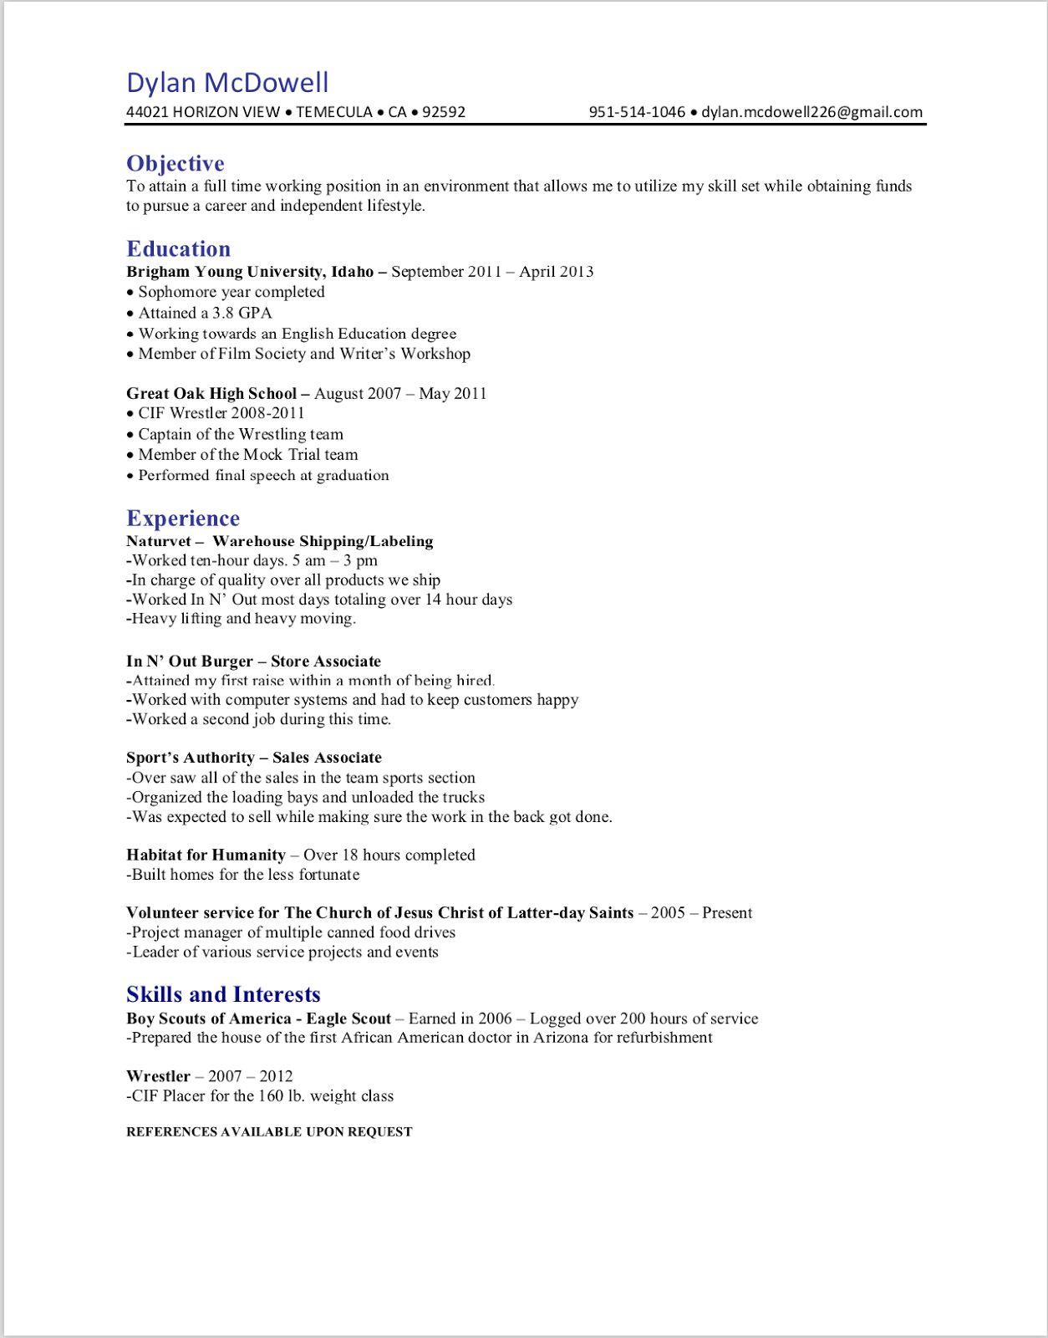
Sophomore Year
C-
Not detailed at all
Inconsistent formats & colors
No demonstrable skills
No STAR bullet points
No quantitative figures
Not tailored to a job
Definitely was not a PDF…

Slide 12
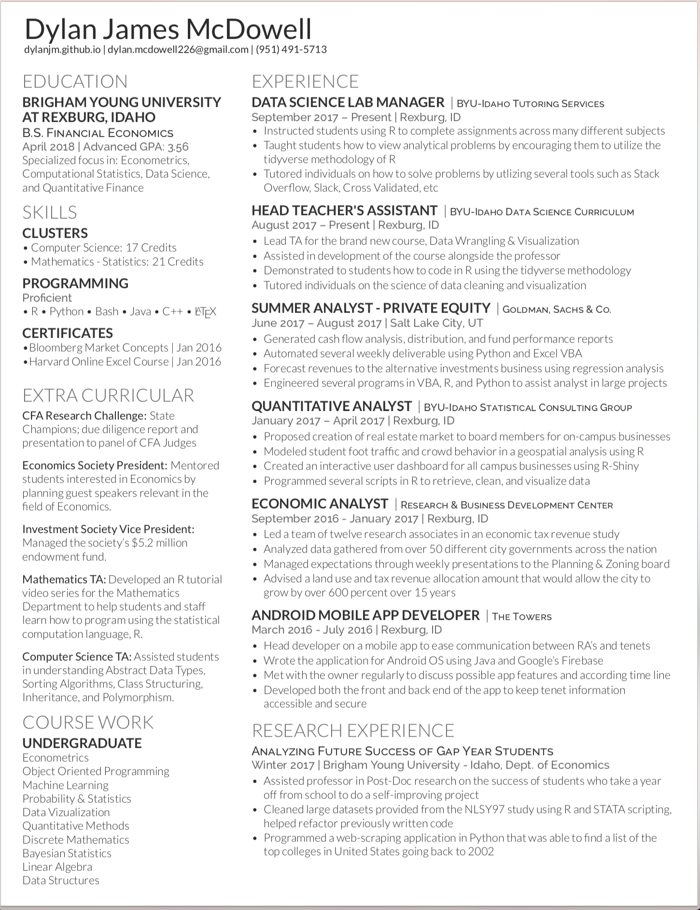
Senior Year
A-
Extremely detailed
Consistent formatting
My skills are apparent throughout
Better Bullets – Not quite STAR
Several quantitative figures
Extremely tailored to finance

Slide 13
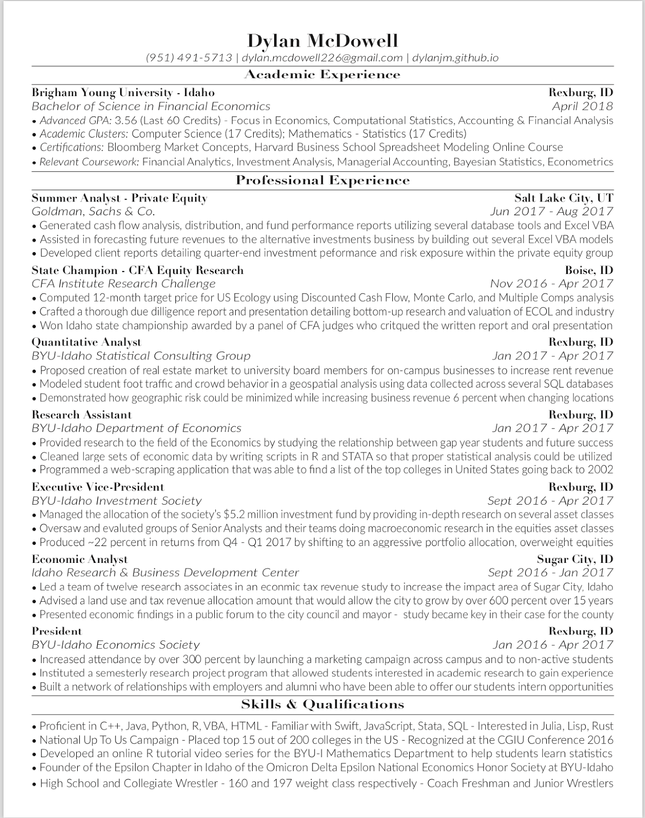

Slide 14
*WARNING* OPINIONS AHEAD

Slide 15


Slide 16


Slide 17
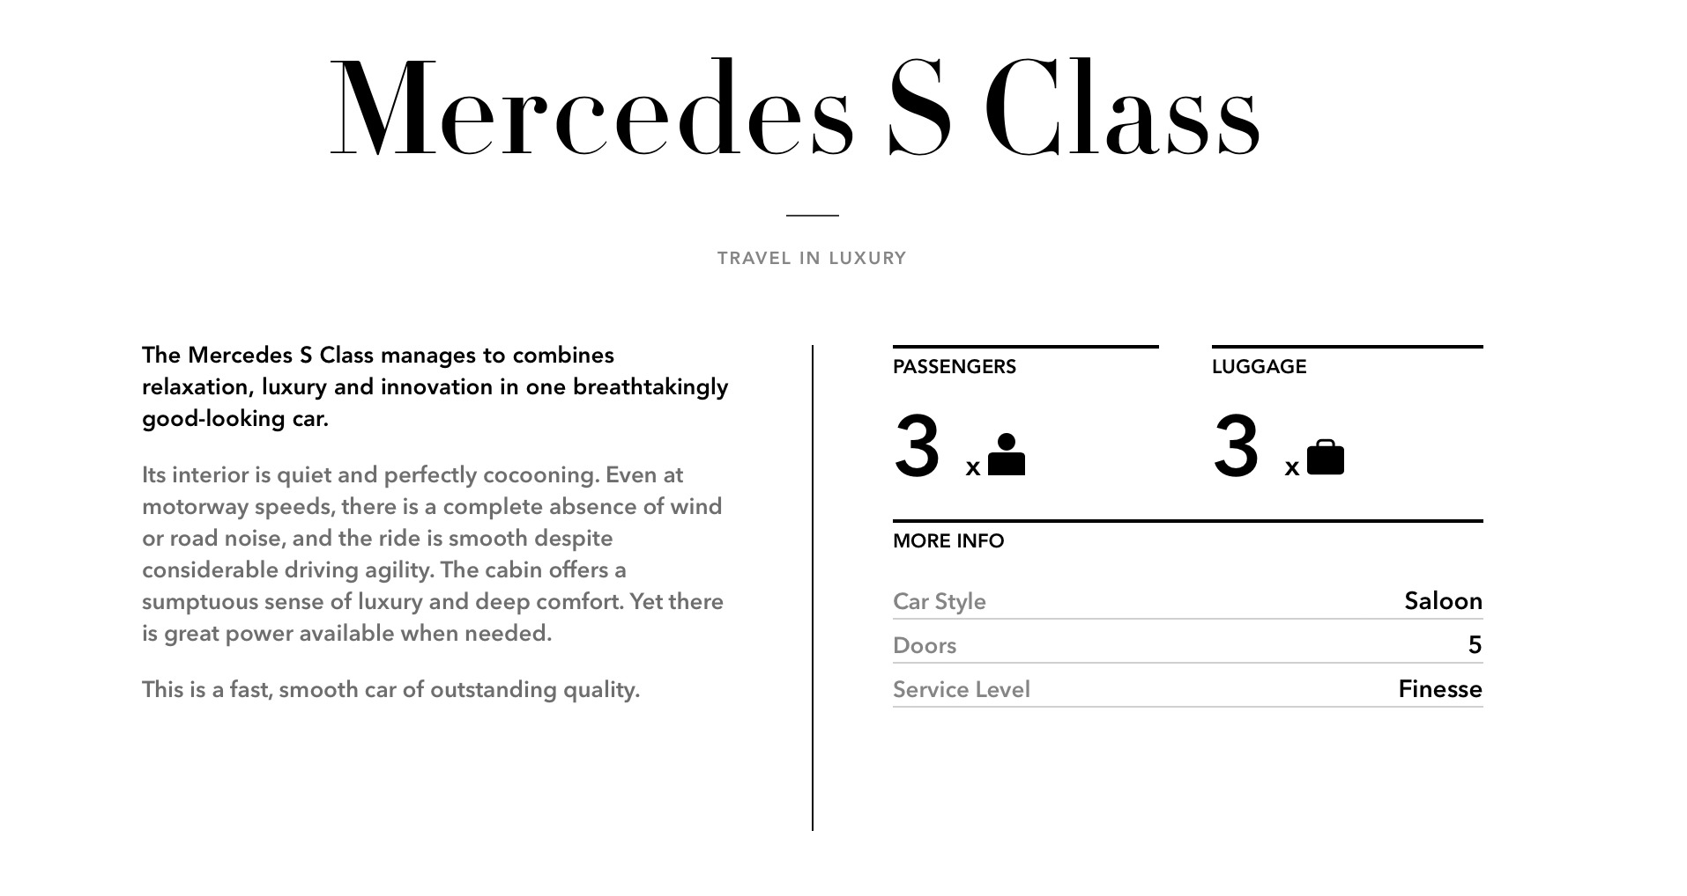

Slide 18
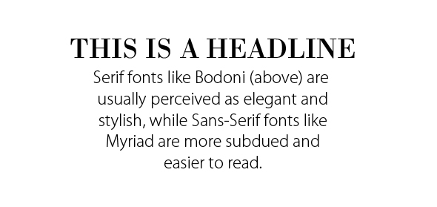

Slide 19

No Hangers
Managed all cash transactions and deposits
Help!!!

Slide 20

How?

Slide 21


Leverage your Resources
People in industry
Alumni from BYU-Idaho
Career Development Center
Professors
Upper classman
Yourself

Slide 22
Tools

Slide 24
https://github.com/dylanjm/resumeResources

